Slide 1

MICRO PROJECT

Slide 2
Smart Bridge - Automatic Height increase when flooding
E.Tittu -21R21A0584
A.Pavan kumar -21R21A0570
G.Vasanthi -21R21A0590
G.Harsha -21R21A0587
D.Vamsi krishna -21R21A0582

Slide 3
CONTENTS
Abstract
Literature Survey
Software Requirements
Hardware Requirements
Functional Requirements
Non-Functional Requirements
System Architecture
Advantages & Disadvantages
Conclusion

Slide 4
ABSTRACT
Bridges are the foundation of a country’s transport and they are expensive to build and maintain.
In recent years, due to increase in different global climatic conditions, bridges have been damaged.
To over come this problem, a smart bridge system is introduced to maintain the bridges in a proper conditions at different climatic conditions.
Here,the height of the bridge increases automatically whenever the water level reaches its maximum point, and it prevents from the damage caused to bridge.

Slide 5
Literature Survey
Title | Author’s name | Technology used | Description
Smart Bridge: An Adaptive Bridge Design for Flooding Events | A. Smith et al (2018) | Arduino UNO | It discusses the design considerations, implementation challenges, and benefits of such a system.
Automatic Bridge Height Control System for Flood Management | C. Brown et al (2020) | Arduino UNO | The paper presents a detailed design methodology, control algorithms, and experimental validation.
Sensing and Control Technologies for Flood Adaptive Bridges | G. Li et al. (2020) | Node MCU ESP8266 | It discusses various flood detection sensors, control algorithms, and integration strategies for effective bridge height adjustment.

Slide 6


Software Requirements
C++ Language
Arduino IDE

Slide 7
Hardware Requirements
Arduino UNO
Servo Motor
Bread Board
Soil Moisture Sensor
Jumper Wires
Arduino Cable

Slide 8
Functional Requirements
Flood Detection: The system should be equipped with flood detection sensor.
Height Adjustment Mechanism: The bridge should be equipped with a height adjustment mechanism that allows it to be raised when flooding is detected.
Safety Measures: The system should incorporate safety features, such as barriers or warning signs, to prevent vehicular or pedestrian access to the bridge while it is being raised or during flooding conditions.
Maintenance and Testing: Regular maintenance and testing procedures should be established to ensure the proper functioning of the flood detection sensors.

Slide 9
Non-Functional Requirements
Smart Bridge provides us the way even in the case of
obstacles.
It provides the additional security for the bridge and
also for the people on it.
The transportation can be done in different climatic
conditions.
Bridge is properly maintained and damage to the
bridge is prevented.

Slide 10
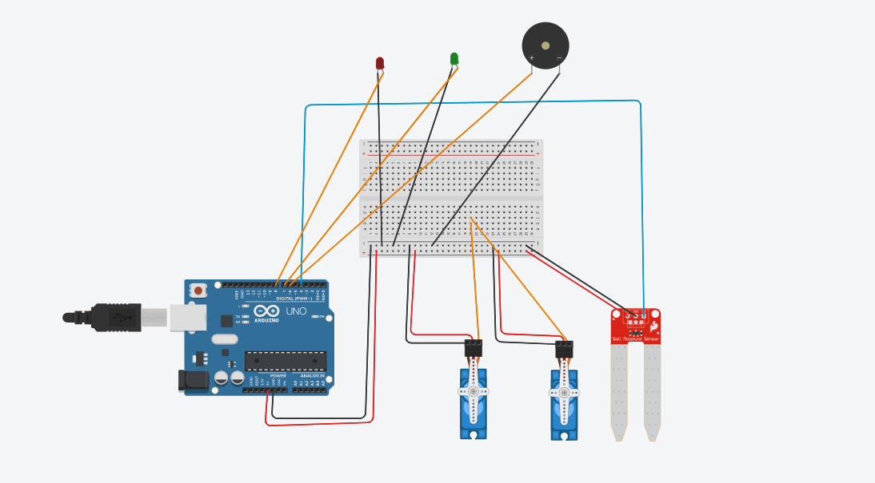
System architecture

Slide 11
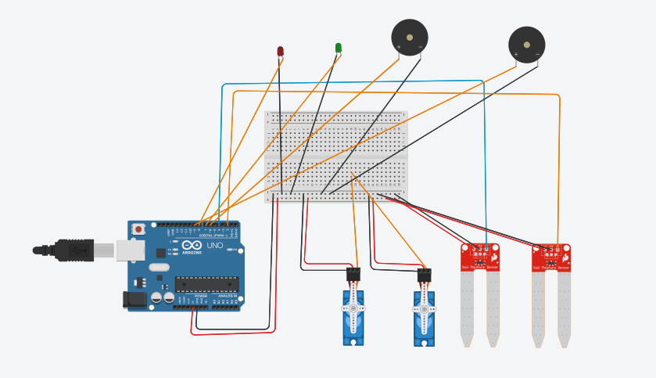

Slide 12
Advantages | Disadavantages
1.Enhanced Safety 2.Quick Response: 3.Reduced Human Error 4.Improved Efficiency 5.Integration with Flood Warning Systems | 1.Initial Cost 2.Maintenance and Upkeep 3.Power Dependency 4.System Complexity 5.Retrofitting Challenges
It is important to carefully consider the advantages and disadvantages of automatic bridge height increase systems when planning for flood management strategies. Site-specific requirements, cost-effectiveness, and the expected benefits in terms of safety and operational efficiency should be evaluated before implementing such systems.

Slide 13
conclusion
The smart bridge is very advance type of bridge
monitoring system.
Bridges can reduce network traffic and it can provide
safety during natural disasters.
The cost of the project is not so high and it can be
used and implemented in all movable bridges without
much increment of cost.
This smart bridge is best in its field and will be most
widely used.

Slide 14


